Slide 1

Registration Form using Kendo UI

Slide 2
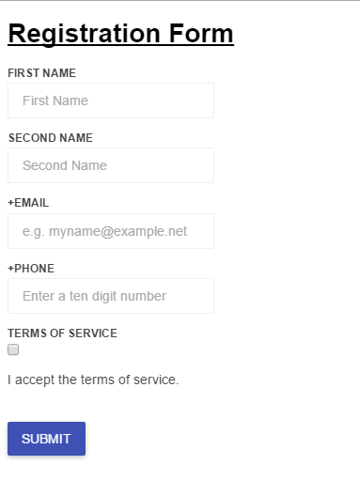
Screenshots of Responsive Form

Slide 3
IF SUBMIT BUTTON IS CLICKED

Slide 4
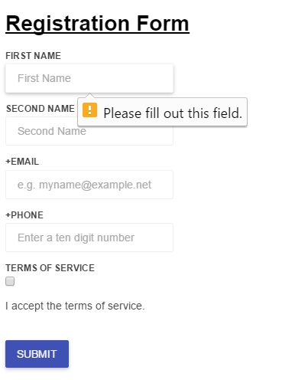
Mentions if we have “Missed Out”

Slide 5
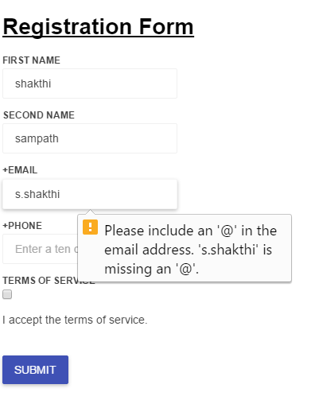
Mentions “mistake” in the fields that are filled

Slide 6
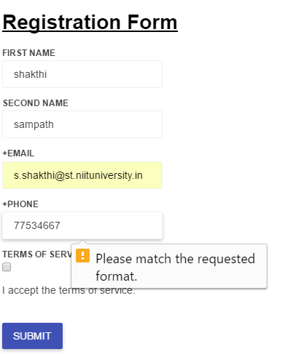
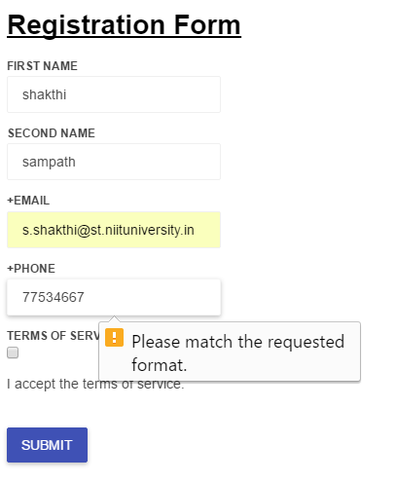
It mentions if the “format” of a field is not followed

Slide 7
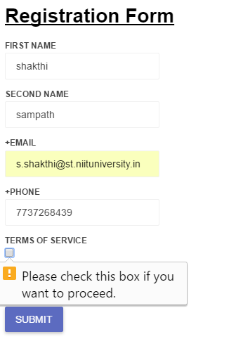

Slide 8
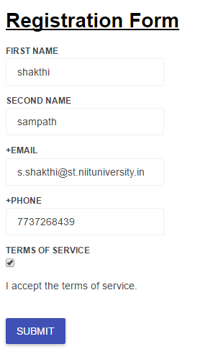
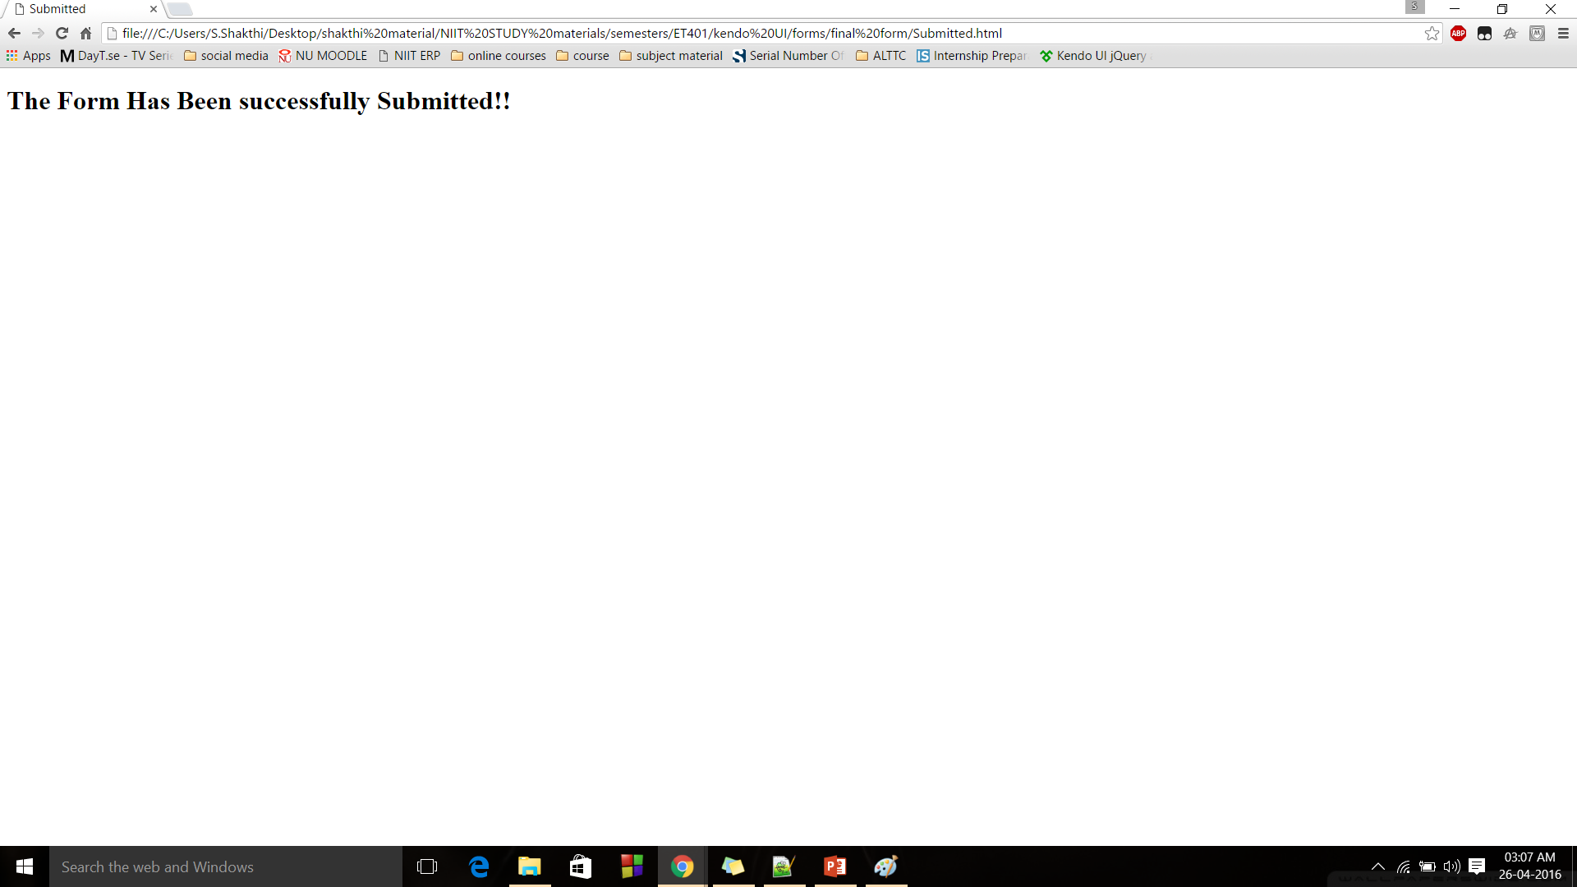
Finally when Submitted
Linked to another Html 5 page Submitted.html

Slide 9
THANK YOU!!

